Slide 1
Haiku
ink brushes paper
five and seven syllables;
season of haiku

Slide 2
Haiku
A Haiku is a short, three line poem
The first and last lines are five syllables.
The middle line is seven syllables.
Haiku are about a short moment of time.
Nature is usually a part of haiku.
Most haiku have a “twisting” word.

Slide 3
Whitecaps on the bay:
A broken signboard banging
In the April wind.
- Richard Wright
Soft upon the eye
bright sky without Day's sun
Moon, the gentle light
- Michael
Cedar leaf rustles
pond ripples upon the shore
mist moves, wind whispers
- Michael
First autumn morning the mirror I stare into shows my father's face.
- Murakami Kijo

Slide 4
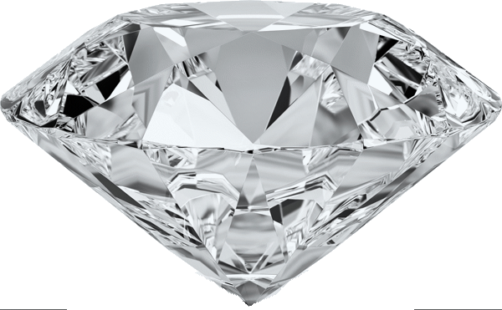
Haiku
Let’s write a Haiku!
First, we need a SUBJECT
The subject is what the poem is about. Most Haiku have something from nature or art as the subject.
tree
flower
air

Slide 5
Haiku
Next we need some season words to match the subjects.
Subject 1
fall
spring
tree
flower
Subject 2
bee
butterfly
air
Subject 3
fresh
winter

Slide 6
Haiku
Now let’s write some adjectives about the subjects.
Subject 1
old
big
tree
flower
Subject 2
beautiful
pink
air
Subject 3

Slide 7
Haiku
Now let’s write some actions related to the subjects.
Subject 1
looking
standing
Subject1
sky
tree
rain
Subject2
flower
Subject 2
opening
moon
Subject3
air
Subject 3
moving
flowing

Slide 8
Haiku
Now we take all of our ideas about each subject and put them together into lines.
Subject 1
fall
spring
old
big
Old tree in the spring
leaves green small, move in the air

Slide 9
Haiku
Now we take all of our ideas about each subject and put them together into lines.
flower
Subject 2
butterfly
beautiful
pink
bee
opening
Pink flower opening; landing on a petal
bee flying down

Slide 10
Haiku
Now we take all of our ideas about each subject and put them together into lines.
Subject 3
air
fresh
winter
moving
flowing
fresh air moving around

Slide 11
Haiku
Old tree in the spring
leaves green small, move in the air
Now let’s choose one subject to write a
haiku about.
Pink flower opening; landing on a petal
bee flying down
fresh air moving around
Pink flower opens
bee flying around and down
landing on petal

